Slide 1
How to use social media for business
Professional practices and information technology.

Slide 2
Introduction
A person checks his/her social media about 4 times and spends 1-2 hrs on it.
We have more access to social media than a newspaper for primary information.
Businesses are seeking ways to promote and advertise their products and service and what better than social media.
Gives them exposure to wide audience ,builds a community.

Slide 3
Plan
start with a plan and build a profile
Since it’s so easy to use and you can get started right away, it might be tempting to dive in and just start posting but without a plan, you have no way of knowing what you’re trying to achieve with your social media posts, and no way to measure whether you get there.
1)What are you hoping to achieve through social media marketing?
2)Who is your target audience?
3)What message do you want to send to your audience with social media marketing?

Slide 4
Presentation
The best way to do this is to create an online presence that's a perfect representation of who you are both online and offline.
You need by translating your brand through visual marketing. From your logo to your website, blog and social media graphics - you need to design a look and feel that matches your persona.
2.Attract the right Potential Clients
Attracting potential clients is an art , you can get lot of likes and followers community but you are missing out the point here that you need to attract right kind of people ,that is what matters for your business to build a clientele

Slide 5
What you must intrigue people is they’re curious about your products or services
1)you offer exclusive promotions
2)your content is entertaining
3)they need to reach a customer service representative
4)their friends or family follow your brand
Run a contest. Promote flash sales and discounts. Give incentives .
So make sure your content is worth following. As you’ve seen, getting more followers will ultimately increase your chances of driving more sales.
Build good relations by replying queries ,taking reviews ,appreciate user content and good feed backs of your product or services. These all measures will enhance your social marketing and make people follow and be your customers.

Slide 6
Advertisement
Companies and individual use social media platform for their advertisement purposes.
For example
International brands:
Nike, Adidas, McDonald’s etc.
Local Brands:
Khaadi, Gul Ahmed, Utilities stuff etc.

Slide 7
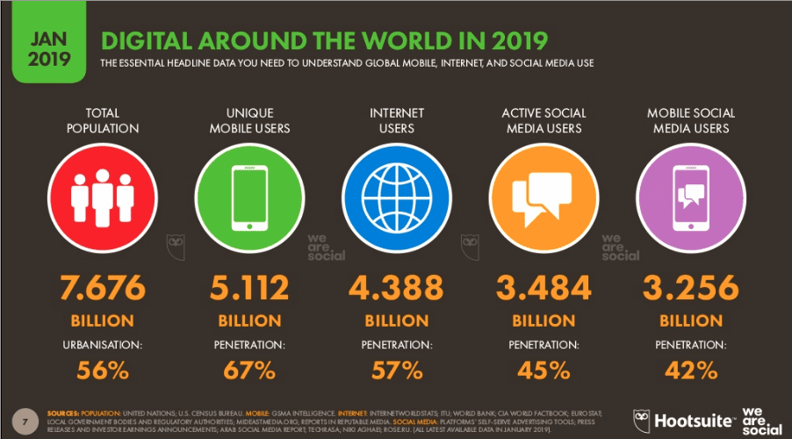

Slide 8
Partnership with celebrities
Companies paid celebrities to promote their brands.
This strategy mainly hits the audience who are fans of that particular celebrity.

Slide 9
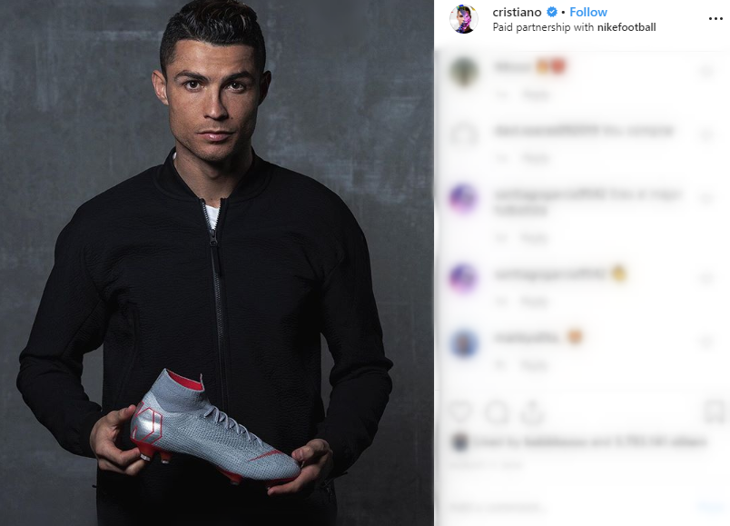

Slide 10
Starting your Own
Individual or companies setup their own business profiles or channels.
They get maximum followers or subscribers to send their products to more folks.
Hitting the right area:
By studying their followers and their interest and offering related products.
They are themselves role model:
People will attract if their products/ brands are like related to them.

Slide 11


Slide 12
Make visual contents and use video representations
Start by translating your brand through visual marketing.
From logo to website, social media graphics .You need to design a look and feel that matches your persona.
Twitter’s internal data, for example, shows that people are three times more likely to engage with Tweets that have visual elements like a pics or videos.
Instagram, Pinterest, and Snapchat, in particular, are visual-first networks.

Slide 13
Provide customer satisfaction and build relations
Relationship is the root of Business.
Building relations with other firms as cement companies need relation and contracts of a constructional builder firm
But What is more important in building relations with Customer is bringing satisfaction.
Social Media allows you to talk directly to customers and followers.

Slide 14
diversity efforts
We’ve all heard the saying, “Don’t put all your eggs in one basket.”
it’s important you understand your target market.
Before you rush to create a profile on all the channels, it’s important you understand your target market.
For the most part, starting with a Facebook profile is a safe bet. With nearly 1.5 billion daily active users.

Slide 15
Conclusion
Build a Starting plan and build a profile of your self.
Know your audience and target right people.
make a commitment and be passionate about your work.
repurpose your content and use automated publishing strategies
boost your posts and place ads of your businees for promotion
make visual contents and use video representations.
make discount offers and give incentives.
provide customer safsitaction and build relations
use multiple social media platforms to promote business and diversity efforts

